Slide 1
Socialisation
Dr. Ayushi Jain
Dept Of Community Physiotherapy
MGM Institute Of Physiotherapy
Chh. Sambhajinagar

Slide 2


Slide 3
Socialization is a process of learning that enables the learner to perform social roles and ability to participate in social system.
‘The process by which the individual learns to conform to the group norms’—Ogburn

Slide 4
concept
Human behavior is acquired.
The existence of society and social processes is possible with socialisation.
Individual exposed himself to the varied experiences in the society, follows the procedures and practices of social groups and develops his distinct personality.
The individual shares the culture of the group and acquires the ways of behaviour through methods of learning. Eg: Imitation, conditioning, and specific training.

Slide 5
Influence of Social Factors in Personality Development
The term ‘personality’ is developed from ‘persona’ means mask.
Personality enables the person to stand out as distinct from others.
It is the totality of the individual which includes thinking, attitude, interests, acting, personal philosophy of life, physical, mental, emotional, temperamental make-up and how it shows itself in the behaviour development.
Thus personality is the pattern developed by the integrated functioning of all the traits and characteristics of an individual.
An organised holistic behaviour of an individual represents modes of behaviour, interests, attitudes, beliefs, values, capacities, abilities, attitudes, physique, intelligence and experience.

Slide 6
Factors or Variables to be Considered in Personality Analysis
Integral aspects of individual. Eg: Basic drives, feelings, physiological systems, physical features, endocrine glands.
Social situations—exterior to the individual, which will modify and directs the impulses, needs. Eg: Family, customs, traditions, culture.
The reaction or behaviour—interaction of the individual to the various stimuli.

Slide 7
Personality is a dynamic growing factor in a social set-up through social experiences.
It consists in a continual adjustment to the environment.
It always striving after goals, which are developed either in its original nature or determined by societal factors.

Slide 8
Social Factors
The social aspects of an individual will affect the personality, i.e. the reactions of other people, his reaction to others and his social environment (family, play-mates, neighbours, school, society or the community in which he lives).
The socialisation of the child first takes place within the home.
Early years of childhood are the most formative years of personality development.
The child acquires the attitudes, habits, needs on the basis of family.
Parent shows interest and takes care of child and tries to fulfill child’s needs and requirements like giving nutrition diet, education, facilitating for enough development for the child’s growth.
The mother, who is the ‘primary care giver’, will influence on the child and maternal affection has significant effect over the child's development.

Slide 9
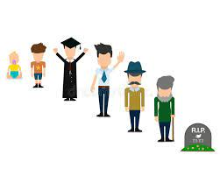
School
It is the primary group, where majority of the children learn to adjust to larger groups of people.
In progressive schools the needs, interests and abilities are concentrated in framing the educational programmes.
The personality of the teacher, the richness of the curriculum, the presence of co-curricular and extra curricular activities influence the childs’ social adjustment.
School provides opportunity for receiving the knowledge, ability to think and reasoning, develops broader outlook in life.

Slide 10

Environment
Socio-cultural environment includes culture, traditions, customs, habits, social relationship, social interaction, social organisation, institutions, values, norms, etc.

Slide 11
Adolescent
The child is highly sensitive, delicate influenced by the people outside family includes teachers, friends, peer groups.
The adolescent engages themselves in creative or constructive activities.
The child fixes certain role models and personality begins to take definite shape.

Slide 12
Adulthood
Family formation, career, sexual behaviour adjustment with new environment influences their lives.
He has to adopt himself to the environment and functions effectively to perform concerned social roles.

Slide 13
Old age
Environment directly or indirectly influences last segment of individual’s life.
Divorce, children behaviour, death of life partner, retirement, dependency, loneliness, health impairment, deterioration, adjustment difficulties, etc. influences the nature of personality.
The individual and social system interacts with each other in a refined social environment motivates a person to acquire right behaviour, character and values.

Slide 14
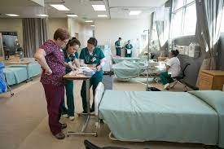
Socialisation in Hospitals
Hospital is a miniature society, where the client can be socialised for better prognosis.
The health care professionals have to establish good interpersonal relationship with the client and his family; gains the confidence of the client thereby the client will be able to express their ideas freely with the health care team members.
The team members have to understand and utilise certain factors, which are influencing social process in implementation of care-oriented activities.

Slide 15
factors
language
Identification
Imitation
Suggestion

Slide 16
Socialisation in the Rehabilitation of the Clients
Socialisation is the process by which the individual is moulded himself to fit for the society to perform social roles and activities effectively.
Rehabilitation is the process whereby the health care professionals give certain skill oriented training activities for the clients to bring back to their normal productive, activities.
It is a part of tertiary prevention

Slide 17
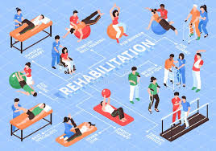
Rehabilitation
‘It is a combined and coordinated use of medical, social, educational, vocational measures for training and retraining the individual to the highest possible level of functional ability’.

Slide 18
types
educational
psychological
vocational
social

Slide 19
Thankyou

